Slide 1
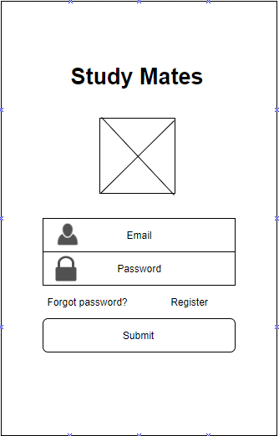
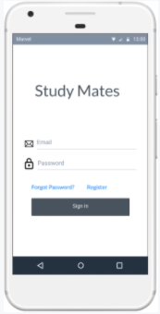
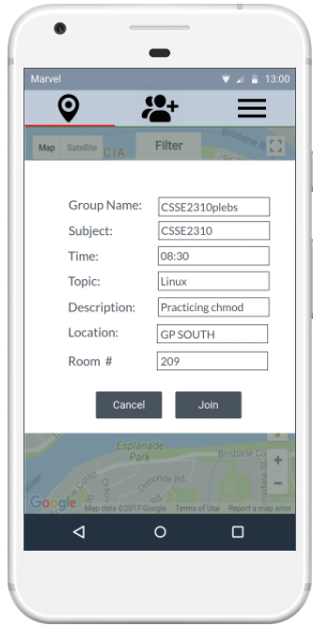
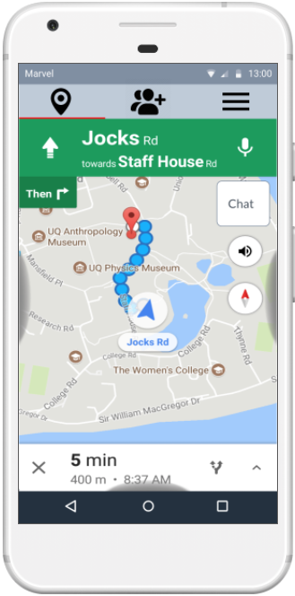
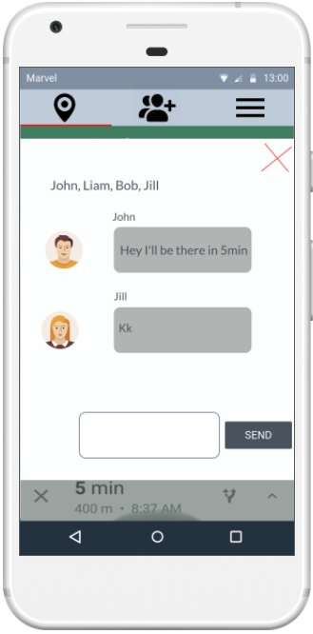
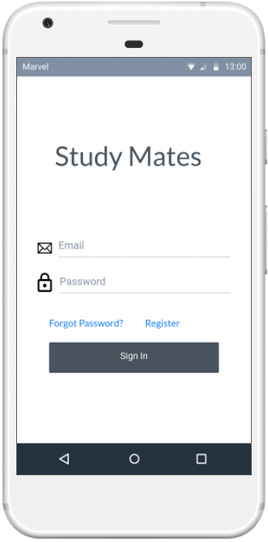
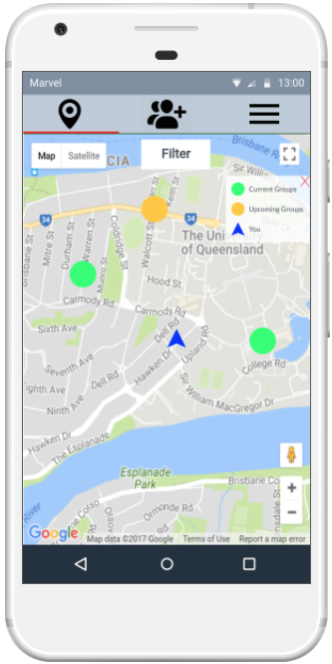
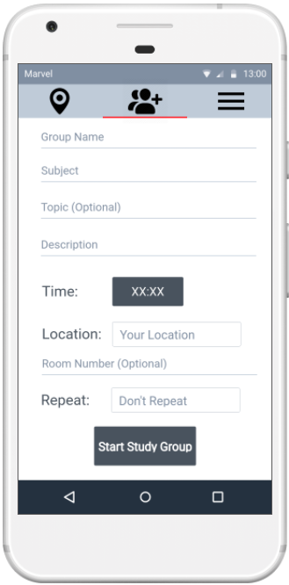
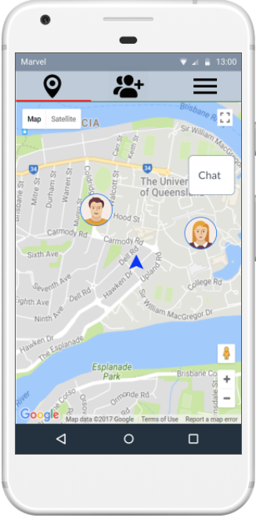
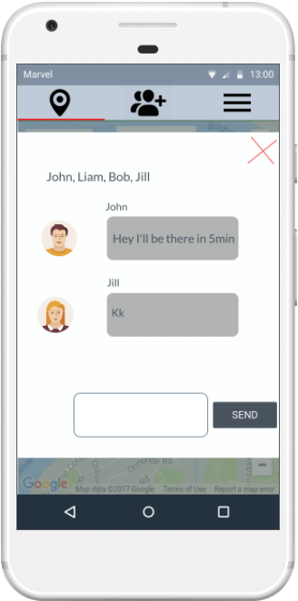
Study Mates
Introduction
Design Process
Overview
Universities provide the environment to facilitate group study by giving students free access to rooms and tables which groups can be stationed at. However, they do not provide tools for students to form and organise study groups. Study Mates aims to address this.
Study Mates is a mobile application designed to connect students together by providing a platform where they can organise study group sessions using the facilities accessible at University. It provides a map view of the university and displays study sessions that are on going or scheduled and provides navigation assistance to help students find these groups. Students can also start study groups by providing the details such as subject, time and location and have them appear on the map.
User Input/Research
User interviews were conducted on UQ students to obtain a clearer view of the problem space and Identify students need/pains when it comes to group study. Research was conducted to identify if there were similar applications in the problem space and the significance of group study.
Initial Conceptual Design
Wireframes were built to help conceptualise the initial design of the prototype. This design was then incorporated into our digital prototype using marvel app. The digital prototype allowed us to gain greater feedback from our users by quickly mocking the experience of a fully functioning app.
Why is group study necessary?
Helps with Procrastination
Many students tend to cram/rush assignments and tests on the eve of the due date. Being in study groups, meeting at scheduled times can keep members from procrastinating
2. Understand information more efficiently
By sharing individuals unique talents and insights group members are able to fill in gaps in their knowledge all the while reinforcing their strengths.
By having the opportunity to explain concepts
3. Good Company
Studying by yourself can be boring and monotonous, leading students to avoid it. Study groups bring a positive social aspect where problems can be discussed help making it more enjoyable
Source: Montclair State University. “Study Group Tips and Advantages.”:
Prototyping
The prototyping process involved each team member working on different areas. One member was focused on designing and evaluating the digital prototype. While the rest began work on developing the front end and back end for our app focusing on key features such as joining/starting a group as well as navigation so that these features could be more closely tested using walkthroughs.
User Testing
After each phase both the app and digital prototype would be tested on the same students we initially interviewed. Feedback from the digital prototype allowed us to further optimise the layout and design of our app. While feedback from the app helped us identify additional needs users expected from functionality inside the app. This included additional filtering options as well as colour coding markers on the map based on time.
Final Prototype
Sign on conducted with UQ sign on to ensure each user is a current student at UQ
Groups can be filtered on time, course and location
Chat option help engage members with each other before they arrive
Directions To Group
Joining Study Group
Map displaying nearby groups
Starting Study Group
View students joining group
Chat option help engage members with each other before they arrive

